Slide 1
Advanced Dimensional Modeling Concepts

Slide 2
Time Dimension
Time is a unique & powerful dimension in every DM & EDW
Time dimension is very special & should be treated differently from other dimensions
Example of a Star Schema
Fact table records daily orders received by a manufacturing company
Time dimension designates calendar days

Slide 3
FAQs About Time Dimension
Why can’t I just leave out the time dimension?
Dimension tables serve as the source of constraints and as the source of report row headers
A data mart is only as good as its dimension tables
SQL provides some minimal assistance in navigating dates
SQL certainly doesn't know anything about your corporate calendar, your fiscal periods, or your seasons

Slide 4
FAQs About Time Dimension
If I have to have a time dimension, where do I get it?
Build it in a spreadsheet
Some data marts additionally track time of day to the nearest minute or even the nearest second. For these cases separate the time of day measure out as a separate "numeric fact." It should not be combined into one key with the calendar day dimension. This would make for an impossibly large time table.

Slide 5
Time Dimension
Guard against incompatible rollups like weeks & months
Separate fact tables denominated in weeks and months should be avoided at all costs
Uniform time rollups should be used in all the separate data marts
Daily data rolls up to every possible calendar

Slide 6
Time Dimension
Be careful about aggregating non-additive facts wrt time
Examples: inventory levels & account balances
We need “average over time”
SQL AVG ?
SQL supports no “avgperiodsum” operator

Slide 7
Time Dimension
Data mart around individual transactions or around month-end snapshots?
Transaction intensive businesses like insurance
What is the average length of time between the original claim and the first payment to the claimant?
Record of the individual transactions is a poor basis for creating a month-end report for management
Build two versions of the data mart: a tx version & a monthly snapshot version

Slide 8
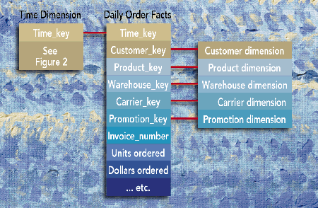
Time Dimension

Slide 9
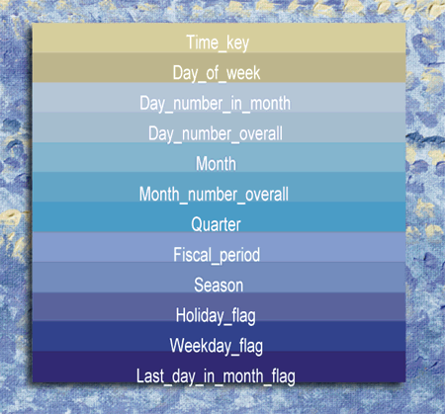
Time Dimension

Slide 10
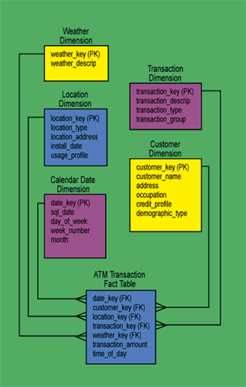
Time Dimension
Time of Day Dimension
Time_key(PK)
Morning Rush Hour
Mid Morning
Lunch Hour
Mid Afternoon
Afternoon rush Hour

Slide 11
Multi-valued Dimensions
Declaring grain of the fact table is one of the important design decisions
Grain declares the exact meaning of a single fact record
If the grain of the FT is clear, choosing Dimensions becomes easy

Slide 12
Multi-valued Dimensions
John & Mary Smith a single household
John has a current account
Mary has a savings account
John & Mary have a joint current account, & credit card
An account can have one, two or more customers associated with it

Slide 13
Multi-valued Dimensions
Customer as an account dimension attribute?
Doing so violates the granularity of the dimension table as more than one customer could be associated with an account
Customer as an additional dimension in the FT?
Doing so violates the granularity of the FT (one row per account per month)
Classic example of a multi-valued dimension
How to model multi-valued dimensions?

Slide 14
Bridge Tables
Account to Customer BRIDGE table
Fact Table
Account Dimension
Bridge Table
Customer Dimension
account_id
account_id
account_id
customer_id
Account- related attributes
customer_id
Customer- related attributes
weight

Slide 15
Multi-valued Dimensions
In the classical Grocery Store Sales Data Mart, the following dimensions are obvious for the daily grain:
Calendar Date
Product
Store
Promotion (assuming the promotion remains in effect the entire day)
What about the Customer & Check-out clerk dimensions?
Many values at the daily grain!

Slide 16
Multi-valued Dimensions
We disqualified the customer and check-out clerk dimension
Many dimensions can get disqualified if we are dealing with an aggregated FT
The more the FT is summarized, the fewer no. of dimensions we can attach to the fact records
What about the converse?
The more granular the data, the more dimensions make sense!!

Slide 17
Multi-valued Dimensions
Single-valued dimensions are welcome
Any legitimate exceptions?
If yes, how to handle them?
Example: Healthcare Billing
Grain is individual line item on a doctor/hospital bill
The individual line items guide us through to the dimensions

Slide 18
Multi-valued Dimensions: Healthcare Example
Dimensions
Calendar Date (of incurred charges)
Patient
Doctor (usually called ‘provider’)
Location
Service Performed
Diagnosis
Payer (insurance co., employer, self)
In many healthcare situations, there may be multiple values for diagnosis
Really sick people having 10 different diagnoses!!
How to model the Diagnosis Dimension?

Slide 20
Multi-valued Dimensions: Healthcare Example
Modeling Diagnoses Dimension: 4 ways:
Disqualify the Diagnosis Dimension because it is MV
Choose primary diagnosis & ignore others
Extend the dimension list to have a fixed number of Diagnosis dimensions Location
Put a helper table in between this fact table and the Diagnosis dimension table

Slide 21
Multi-valued Dimensions: Healthcare Example
Disqualify the Diagnosis Dimension because it is MV
Easy way out but not recommended
Choose primary diagnosis & ignore others
Primary or admitting diagnosis
Modeling problem taken care of, but is the diagnosis information useful in any way?
Extend the dimension list to have a fixed number of Diagnosis dimensions Location
Create a fixed number of additional Diagnosis dimension slots in the fact table key
There will be some complicated example of a very sick patient who exceeds the number of Diagnosis slots you have allocated
Multiple separate Diagnosis dimensions can not be queried easily
If "headache" is a diagnosis, which Diagnosis dimension should be constrained?
Avoid the multiple dimensions style of design as logic across dimension is notoriously slow on relational databases

Slide 22
Multi-valued Dimensions: Healthcare Example
Helper Table Approach
Place a "helper" table between the Diagnosis dimension and the fact table
The Diagnosis key in the fact table is changed to be a Diagnosis Group key
The helper table in the middle is the Diagnosis Group table
It has one record for each diagnosis in a group of diagnoses
If I walk into the doctor's office with three diagnoses, then I need a Diagnosis Group with three records in it
Either build these Diagnosis Groups for each individual or a library of "known" Diagnosis Groups

Slide 23
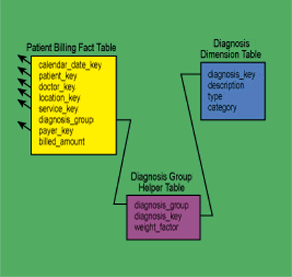
Multi-valued Dimensions: Healthcare Example
A helper table for an open-ended number of diagnoses

Slide 24
Multi-valued Dimensions: Healthcare Example
Helper Table Approach
The Diagnosis Group table contains a very important numeric attribute: the weighting factor
The weighting factor allows reports to be created that don't double count the Billed Amount in the fact table
For instance, if you constrain some attribute in the Diagnosis dimension such as "Contagious Indicator" with the values Contagious and Not Contagious, then you can group by the Contagious Indicator and produce a report with the correct totals. To get the correct totals, we must multiply the Billed Amount by the associated weighting factor
Assign the weighting factors equally within a Diagnosis Group. If there are three diagnoses, then each gets a weighting factor of 1/3
All weight factors in a Diagnosis Group always add up to 1

Slide 25
Multi-valued Dimensions: Healthcare Example
Helper Table Approach
Deliberately omit the weighting factor and deliberately double count the same report grouped by Contagious Indicator
An "impact report" is produced, that shows the total Billed Amount implied partially or fully by both values of Contagious Indicator.
Correctly weighted report is the most common and makes the most sense
Impact report is interesting and is requested from time to time. Such an impact report should be labeled so that the reader is not misled by any summary totals.

Slide 26
Multi-valued Dimensions
Helper Table Approach
Helper table clearly violates the classic star join design where all the dimension tables have a simple one-to-many relationship to the fact table
But it is the only viable solution to handling MV dimensions
We can preserve the star join illusion in end-user interfaces by creating a view that prejoins the fact table to the helper table
Other Applications:
Retail Banks
Standard Industry Classification

Slide 27
Helper Tables for Hierarchies
Helper Tables are useful for handling M:M relationship between FT & DT
One more real world situation which can be modeled using helper tables
Dimension with complex variable-depth hierarchy

Slide 28
Helper Tables for Hierarchies
Constant depth hierarchies:
Store all levels of hierarchy in denormalized dimension table
The preferred solution in almost all cases!
Create “snowflake” schema with hierarchy captured in separate outrigger table
Only recommended for huge dimension tables
Storage savings have negligible impact in most cases

Slide 29
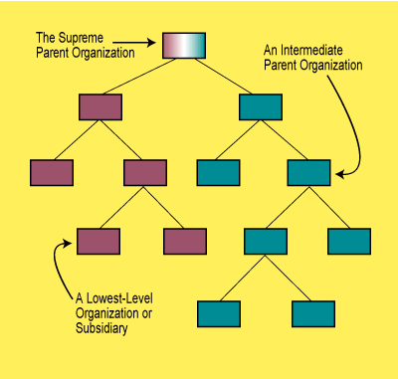
Variable Depth Hierarchies
Examples
Corporate organization chart
Consulting Invoices DM:
Consulting services are sold at different organizational levels
Need for reports that show consulting sold not only to ind. Departments, but also to division, subsidiaries and overall enterprise
The report must still add up the separate consulting revenues for each organization structure

Slide 30
Variable Depth Hierarchies
Examples
Parts composed of subparts
Part1
Subpart 2
Subpart 3
Subpart 4
Subpart 5
Subpart 6
Subpart 7

Slide 31
Handling Hierarchies
Solutions for variable-depth hierarchies?
Creating recursive foreign key to parent row is a possibility
Employee dimension has “boss” attribute which is FK to Employee
The CEO has NULL value for boss
This approach is not recommended
Cannot be queried effectively using SQL
Alternative approach: bridge table

Slide 32
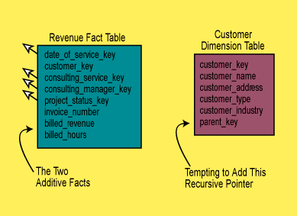
Handling Hierarchies
Creating recursive foreign key to parent row is a possibility

Slide 33
Handling Hierarchies
Creating recursive foreign key to parent row is a possibility
Employee dimension has “boss” attribute which is FK to Employee
The CEO has NULL value for boss
This approach is not recommended
Cannot be queried effectively using SQL
ORACLE does provide “start with” & “connect by”

Slide 34
Handling Hierarchies
Creating recursive foreign key to parent row is a possibility
Employee dimension has “boss” attribute which is FK to Employee
The CEO has NULL value for boss
This approach is not recommended
Cannot be queried effectively using SQL
ORACLE does provide “start with” & “connect by”

Slide 35
Start With & Connect By
The start with connect by clause can be used to select data that has a hierarchical relationship
create table test_connect_by (
parent number,
child number,
constraint uq_tcb unique (child) );
insert into test_connect_by values ( 5, 2);
insert into test_connect_by values ( 5, 3);
insert into test_connect_by values ( 18, 11);
insert into test_connect_by values ( 18, 7);
insert into test_connect_by values ( 17, 9);
insert into test_connect_by values ( 17, 8);
insert into test_connect_by values ( 26, 13);
insert into test_connect_by values ( 26, 1);
insert into test_connect_by values ( 26, 12);
insert into test_connect_by values ( 15, 10);
insert into test_connect_by values ( 15, 5);
insert into test_connect_by values ( 38, 15);
insert into test_connect_by values ( 38, 17);
insert into test_connect_by values ( 38, 6);
38, 26, 16 have no parents
insert into test_connect_by values (null,38); insert into test_connect_by values (null,26); insert into test_connect_by values (null,16);

Slide 36
Bridge Tables
Customer dimension has one row for each customer entity at any level of the hierarchy
Separate bridge table has schema:
Parent customer key
Subsidiary customer key
Depth of subsidiary
Bottom flag
Top flag
One row in bridge table for every (ancestor, descendant) pair
Customer counts as its own Depth-0 ancestor
16 rows for the hierarchy at right
Fact table can join:
Directly to customer dimension
Through bridge table to customer dimension
Customer 1
Customer 2
Customer 3
Customer 4
Customer 5
Customer 6
Customer 7
Fact
Bridge
Customer
parent_id
cust_id
cust_id
child_id

Slide 37
Bridge Table Example
parent_id | child_id | depth | top_flag | bottom_flag
1 | 1 | 0 | Y | N
1 | 2 | 1 | Y | N
2 | 2 | 0 | N | N
1 | 3 | 1 | Y | Y
3 | 3 | 0 | N | Y
1 | 4 | 1 | Y | N
4 | 4 | 0 | N | N
1 | 5 | 2 | Y | Y
2 | 5 | 1 | N | Y
5 | 5 | 0 | N | Y
1 | 6 | 2 | Y | Y
2 | 6 | 1 | N | Y
… | … | … | … | …

Slide 38
Using Bridge Tables in Queries
Two join directions
Navigate up the hierarchy
Fact joins to subsidiary customer key
Dimension joins to parent customer key
Navigate down the hierarchy
Fact joins to parent customer key
Dimension joins to subsidiary customer key
Safe uses of the bridge table:
Filter on customer dimension restricts query to a single customer
Use bridge table to combine data about that customer’s subsidiaries or parents
Filter on bridge table restricts query to a single level
Require Top Flag = Y
Require Depth = 1
For immediate parent / child organizations
Require (Depth = 1 OR (Depth < 1 AND Top Flag = Y))
Generalizes the previous example to properly treat top-level customers
Other uses of the bridge table risk over-counting
Bridge table is many-to-many between fact and dimension

Slide 39
Restricting to One Customer
parent_id | child_id | depth | top_flag | bottom_flag
1 | 1 | 0 | Y | N
1 | 2 | 1 | Y | N
2 | 2 | 0 | N | N
1 | 3 | 1 | Y | Y
3 | 3 | 0 | N | Y
1 | 4 | 1 | Y | N
4 | 4 | 0 | N | N
1 | 5 | 2 | Y | Y
2 | 5 | 1 | N | Y
5 | 5 | 0 | N | Y
1 | 6 | 2 | Y | Y
2 | 6 | 1 | N | Y
… | … | … | … | …

Slide 40
Restricting to One Depth
parent_id | child_id | depth | top_flag | bottom_flag
1 | 1 | 0 | Y | N
1 | 2 | 1 | Y | N
2 | 2 | 0 | N | N
1 | 3 | 1 | Y | Y
3 | 3 | 0 | N | Y
1 | 4 | 1 | Y | N
4 | 4 | 0 | N | N
1 | 5 | 2 | Y | Y
2 | 5 | 1 | N | Y
5 | 5 | 0 | N | Y
1 | 6 | 2 | Y | Y
2 | 6 | 1 | N | Y
… | … | … | … | …

Slide 41
Variable Depth Hierarchies
Examples
Corporate organization chart
How many Records in the Bridge Table?
One record for each separate path from each node in the org. tree to itself & to every node below it
13 nodes (to themselves)
12 nodes below root
4+6 nodes below 1st level
2+4 nodes below 2nd level
2 nodes below 3rd level
TOTAL =
43

Slide 42
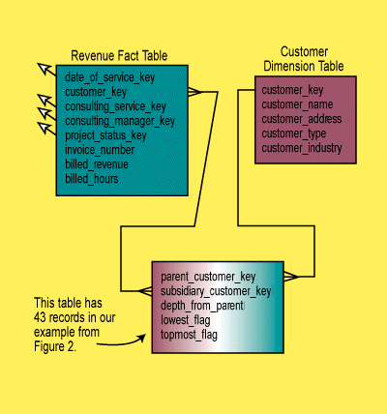
Variable Depth Hierarchies

Slide 43
Variable-Depth Hierarchies
Advantages of bridge table approach:
Any normal dimensional constraint against the Customer dimension table and the helper table will cause all the fact table records for the directly constrained customers plus all their subsidiaries to be correctly summarized.
Standard relational databases and your standard query tools can be used to analyze the hierarchical structure.

Slide 44
Multi-Valued Dimensions
Fact Table
Weights for each account sum to 1
Allows for proper allocation of facts when using Customer dimension
Account Dimension
Bridge Table
Customer Dimension
account_id
account_id
account_id
customer_id
customer_id
Account- related attributes
weight
Customer- related attributes

Slide 45
Weighted Report vs. Impact Report
Two formulations for customer queries
Weighted report
Multiply all facts by weight before aggregating
SUM(DollarAmt * weight)
Subtotals and totals are meaningful
Impact report
Don’t use the weight column
SUM(DollarAmt)
Some facts are double-counted in totals
Each customer is fully credited for his/her activity
Most useful when grouping by customer

